Slide 1

Hybrid Decentralization for Multi-Robot Orienteering with Mothership-Passenger Systems
Nathan L. Butler and Dr. Geoffrey A. Hollinger
Collaborative Robotics and Intelligent Systems (CoRIS) Institute
Oregon State University
NSF Award No.
2322055

Slide 2
Deploying multi-robot team in marine under-ice environments
Mothership

Slide 3
Stochastic Multiagent Orienteering Problem
T
T
?
?
T
T
T
T
T
T
?
?
?
?
T
Unvisited (exceeds budget)
?
T
T
Mothership
Notes:
MOP/SMOP slide

Slide 4
How can we leverage a hybrid centralized-decentralized network available in Mothership-Passenger systems to solve complex orienteering problems?
Notes:
Gap

Slide 5
Hybrid Mission Planning
Observed local data
Received global data
Passenger j
Use up-to-date local observations
Respond quickly to local disturbances
Mothership
Use aggregated global information
Coordinate system-level actions
Locally-informed plans
Globally-informed plans

Slide 6


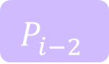


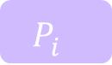
Centralized Planning
Mothership
Mothership
Centralized Solver
(Sim-BRVNS [X])
Centralized Solver
$$P_{i−2}^{}$$
$$P_{i}^{}$$
$$P_{i−1}^{}$$
$$P_{j}^{}$$
$$P_{i}^{}$$
$$P_{k}^{}$$

Slide 7
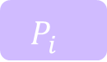


Hybrid Framework
Mothership
Passenger k
Centralized Solver
Stored Plans
Decentralized Solver
Neighboring Robots
Plan Valuation & Selection
$$P_{i}^{}$$
$$P_{j}^{}$$
$$P_{k}^{}$$
Candidate Plans

Slide 8
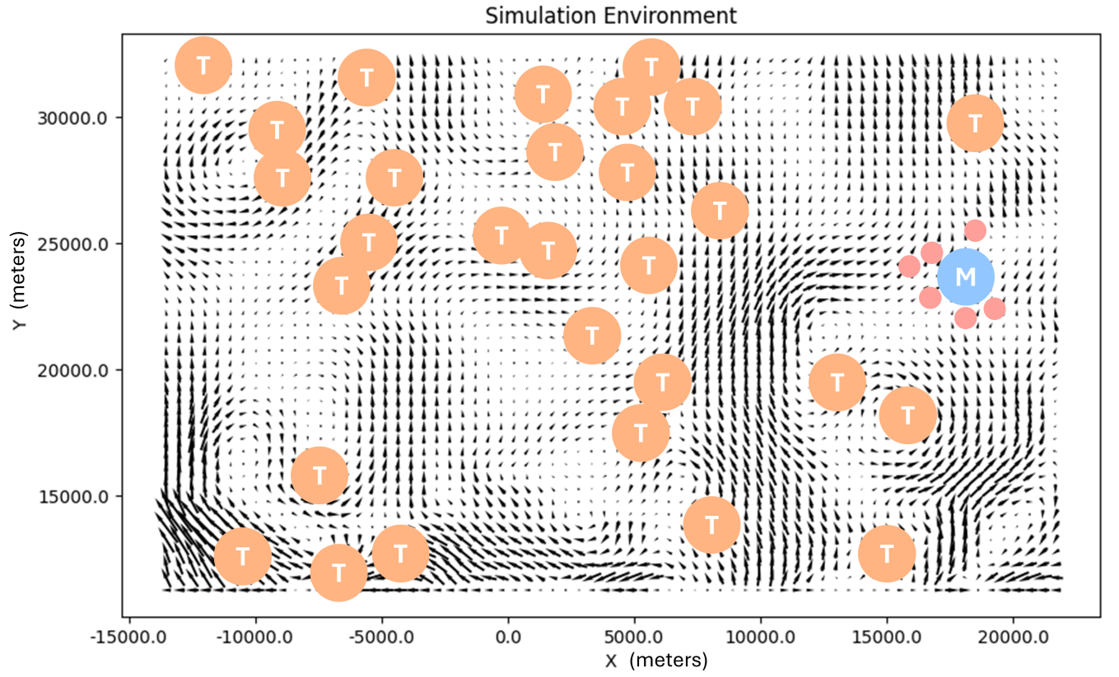
Evaluation in Simulated Ocean Domain
Tasks (T)
Mothership Location (M)
Deployed Passengers

Slide 9
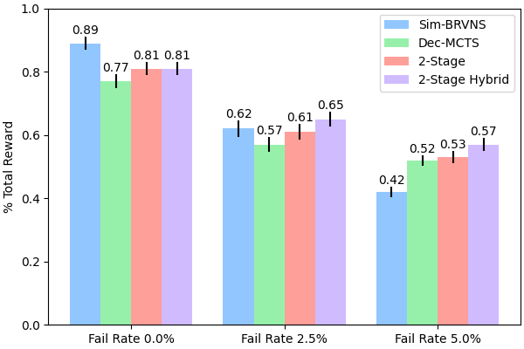
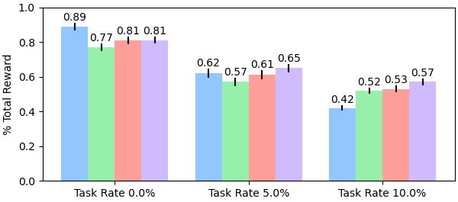
Experimental Results
Algorithms evaluated:
Initial, centralized solution only
Decentralized planning only
6 Robots, 20 Tasks
Initial + decentralized replanning
Initial + hybrid replanning
Task Completion Rate (Higher is better)
Initial (centralized) solution -> immediate coordination boost
Increased disturbances -> greater benefit from global coordination

Slide 10
Conclusions
Introduced Stochastic Multiagent Orienteering Problem
Explored leveraging mothership for hybrid decentralized problem solving
Evaluated scenarios where integrated mothership provides greatest benefits

Slide 11






Contact:
Nathan Butler: butlnath@oregonstate.edu
Dr. Geoffrey Hollinger: geoff.hollinger@oregonstate.edu
NSF Award No.
2322055

Slide 12
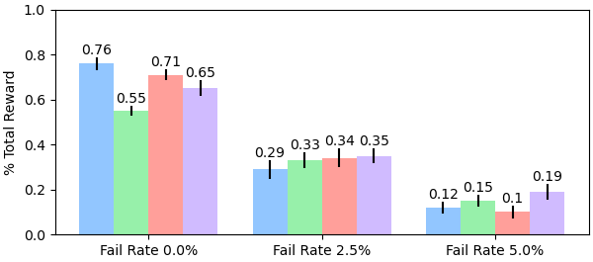
Experimental Results
3 Robots, 30 Tasks
Four algorithms:
Initial, centralized solution only
Decentralized planning only
Initial + decentralized replanning
Initial + hybrid replanning
6 Robots, 20 Tasks
Initial (centralized) solution -> immediate coordination boost
Increased disturbances -> greater benefit from global coordination

